Slide 1




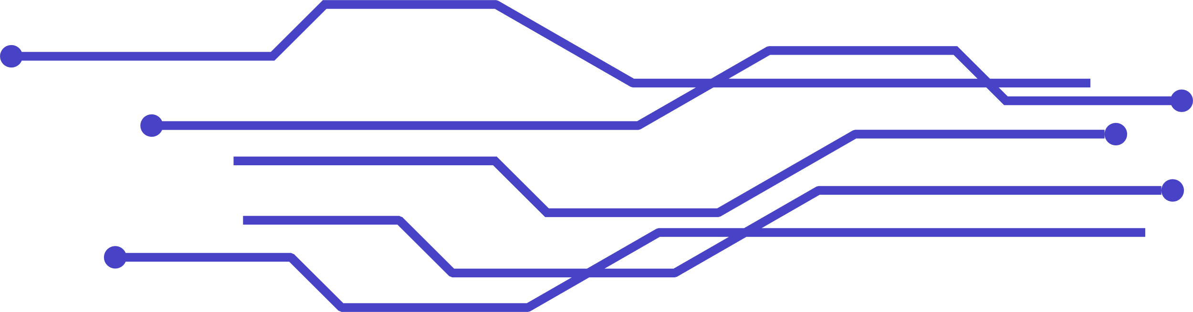
de
runner
APP
Iot system on blockchain network:
principle of operation and implementation
eLENA SAVIĆ
lamija FATIĆ
MAGDALENA OBRADOVIĆ

Slide 2

table of contents
01
02
03
04
Introduction
How it works
Frontend&Solidity
Overview
Hardware
Implementation flow
05
06
07
08
Hardware parts
overview
Communication
system flow
(Blockchain&IoT)
Obstacles and potencial
solutions
Conclusion

Slide 3

1.
introduction

Slide 4

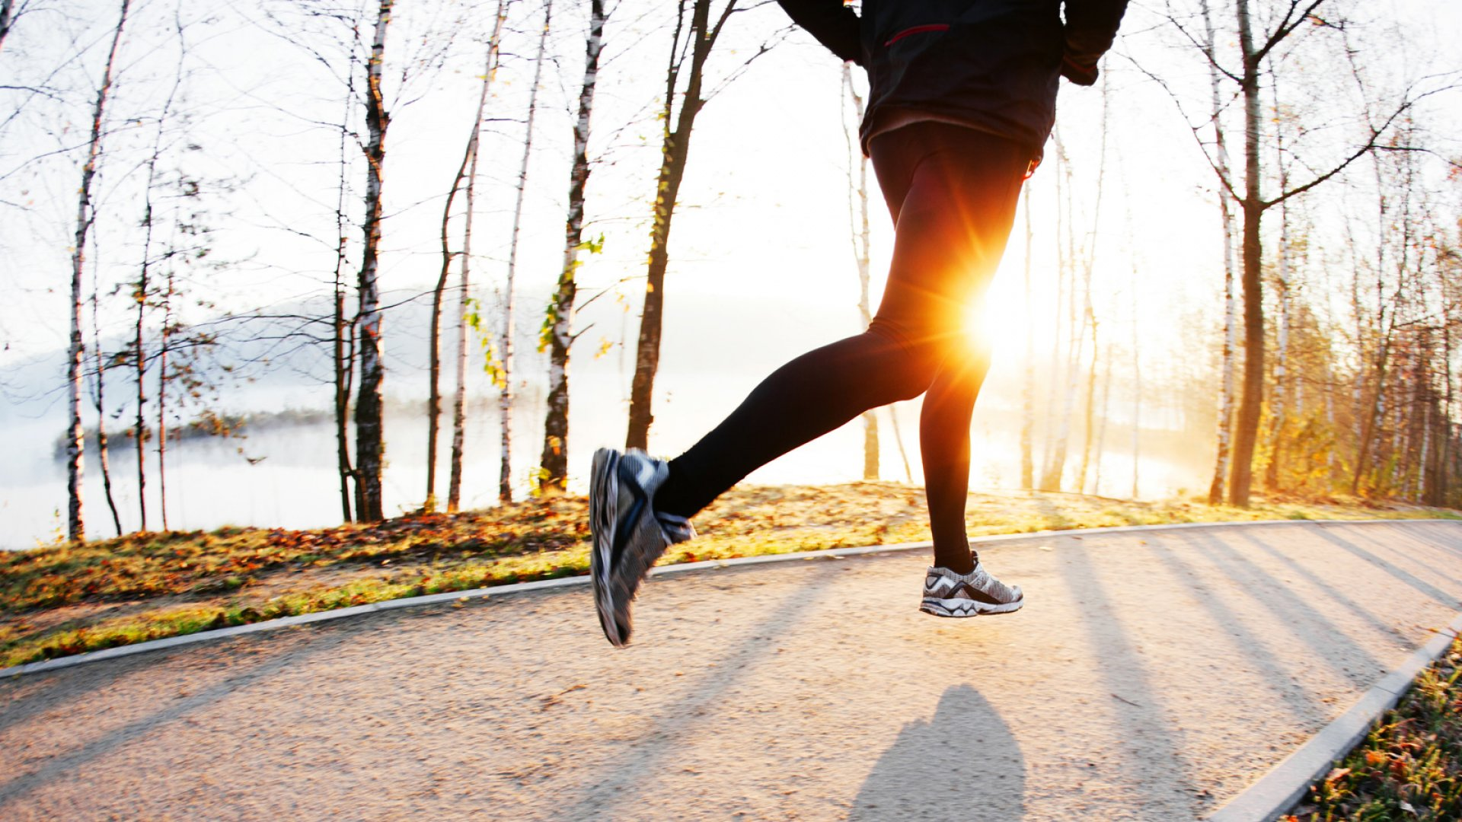
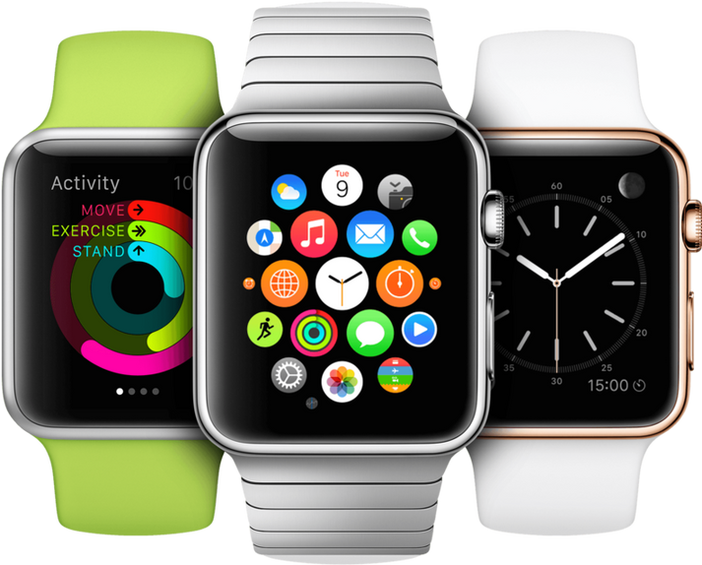

WHAT IS DERUNner?
Blockchain based app
Integration with IoT device
(smart watch)
de
runner

Slide 5







2.
how it works
Challenges & Events
1
Personal&Physical info
Earn or lose
3
RUN
4
User & Device
Registration
2
5
Make a new goal
Community
Daily motivation

Slide 6
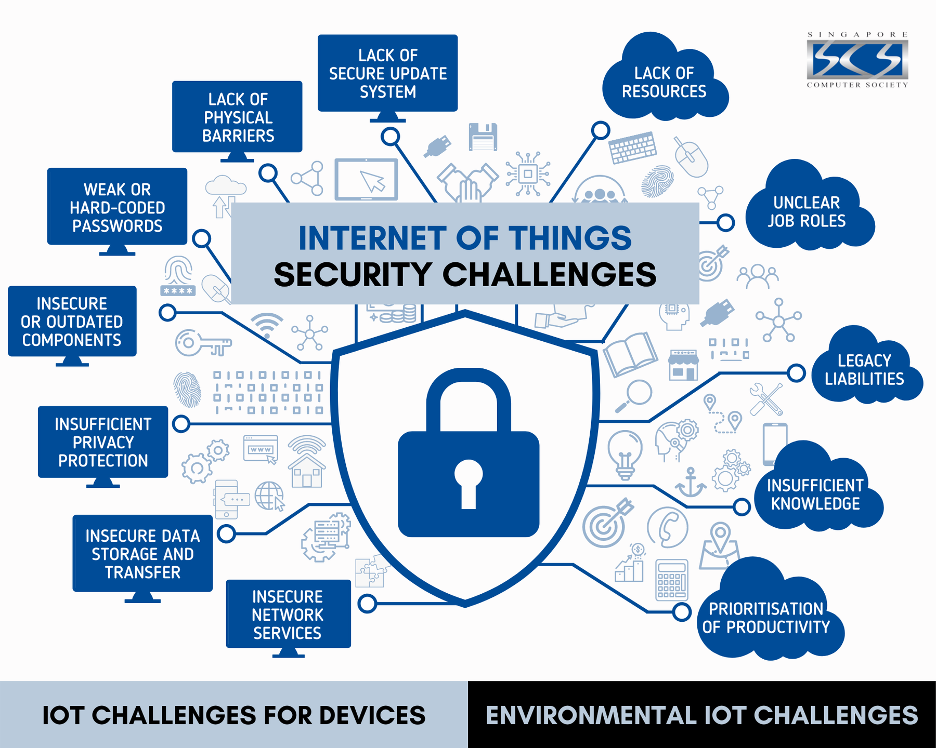
why iot and blockchain?

Slide 7
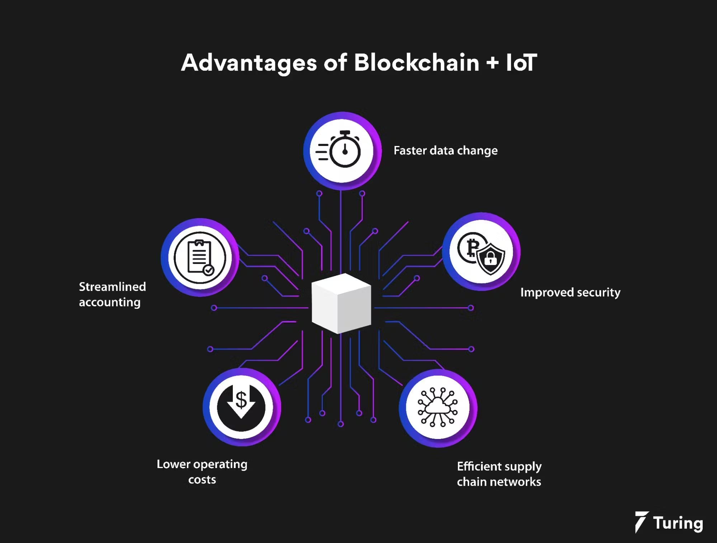
iot+
blockchain

Slide 8
Hardware implementation flow
4.
Main parts of device :
Display
Microproccesor
Memory
Batery
Sensors
Wirelles technologies
Communication modules
Conectors
OS
Control components
Physcial case

Slide 9
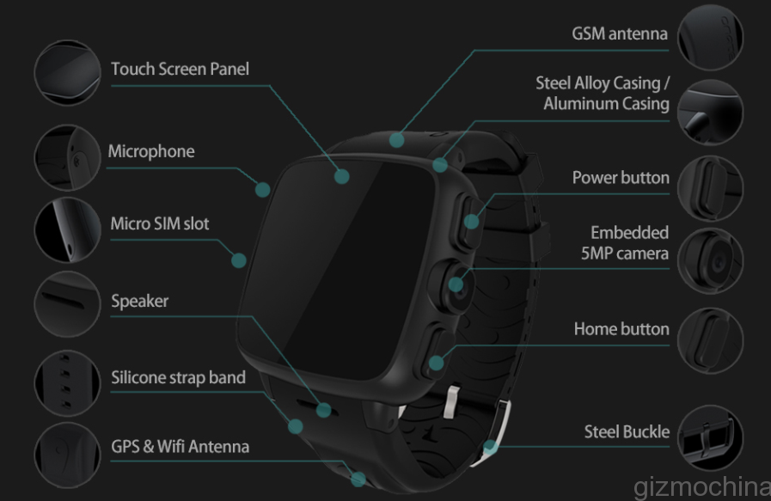

Slide 10


Hardware parts
overview
5.
In order to provide high level of data safety as well as ability to maintain cryptographic operations and authentications with IoT (smart watch) device, we have to consider special implementations of some hardware parts

Slide 11
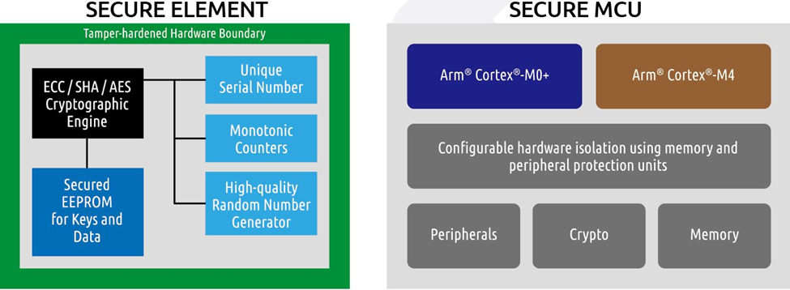
Secure element(se)
Specialized hardware component designed to provide a high level of security for sensitive operations and data.
It is used to store cryptographic keys, perform secure transactions, and execute security-related functions

Slide 12

Secure element(se)
hardware-based encryption
SECURE
STORAGE
tamper
detection

Slide 13
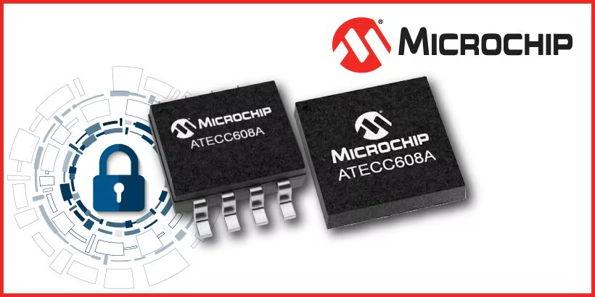
all in one solution: CryptoAuthentication device
AES encryption
physical protection mechanism
firmware development support

Slide 14
2.Secure mcu
MCU needs to provides a complete chain of security on the device with embedded keys and certificates that will verify firmware updates before they are installed.
Works together with SE

Slide 15
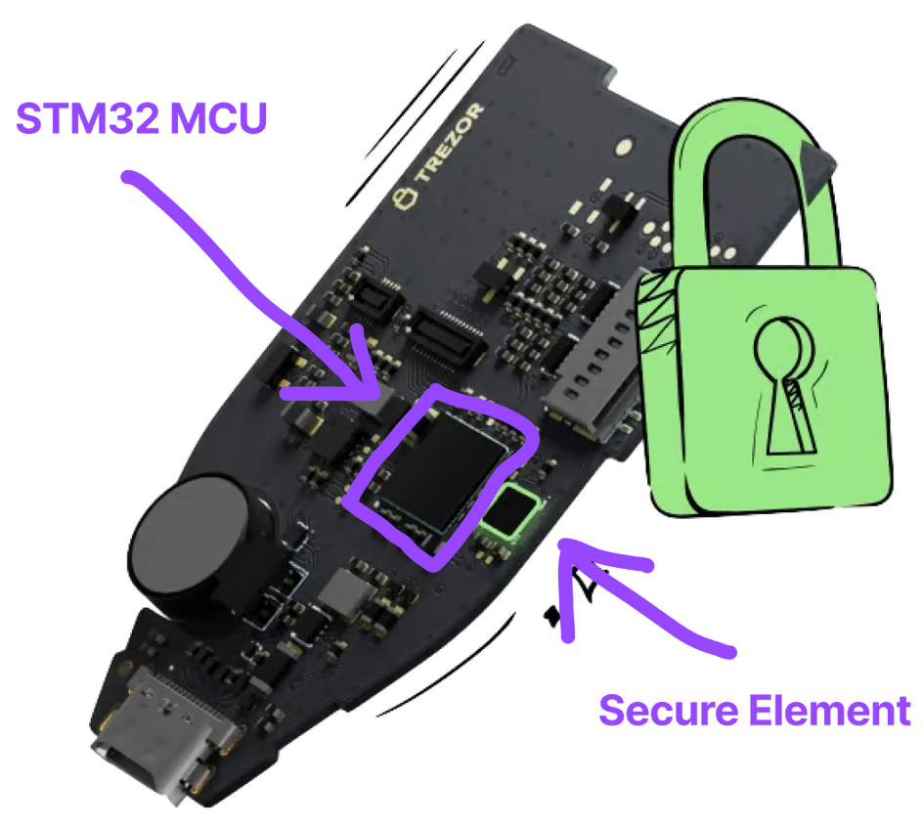
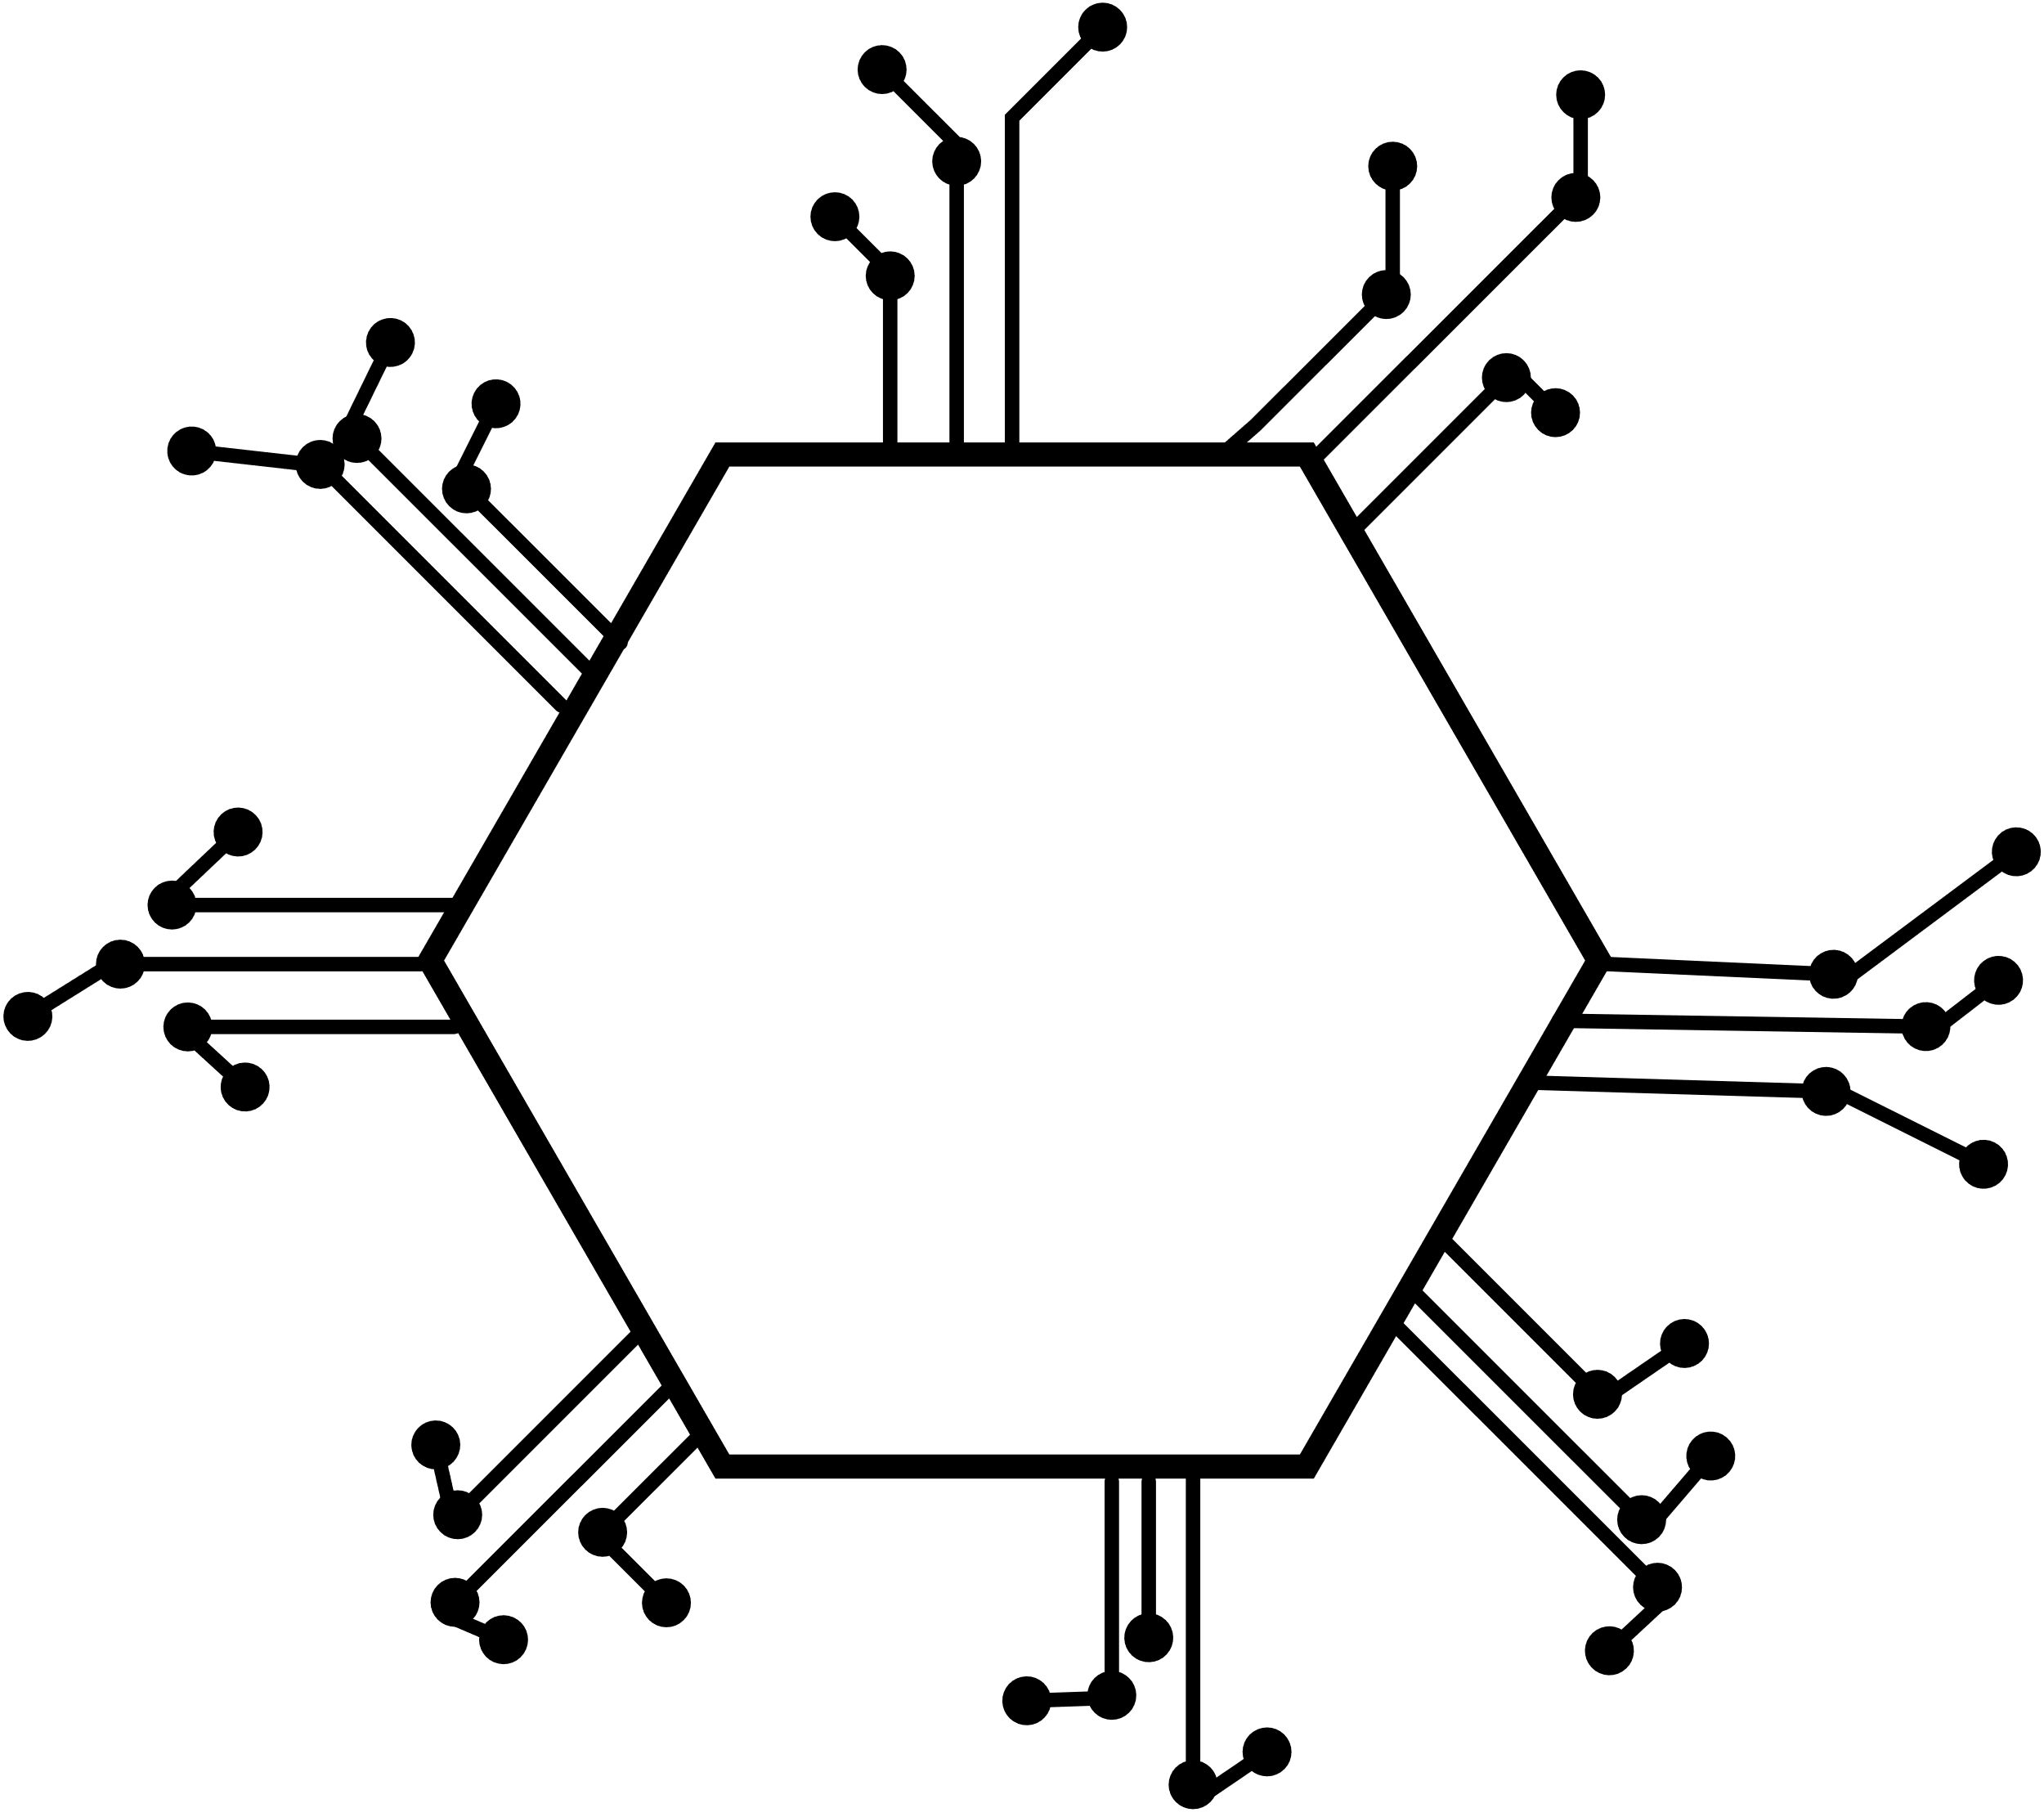
crypto (MCU)
Safeguard against unauthorized access, data breaches, and other security risks

Slide 16
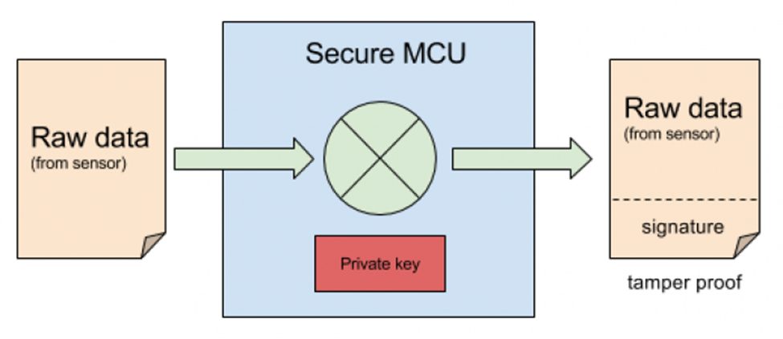

Slide 17

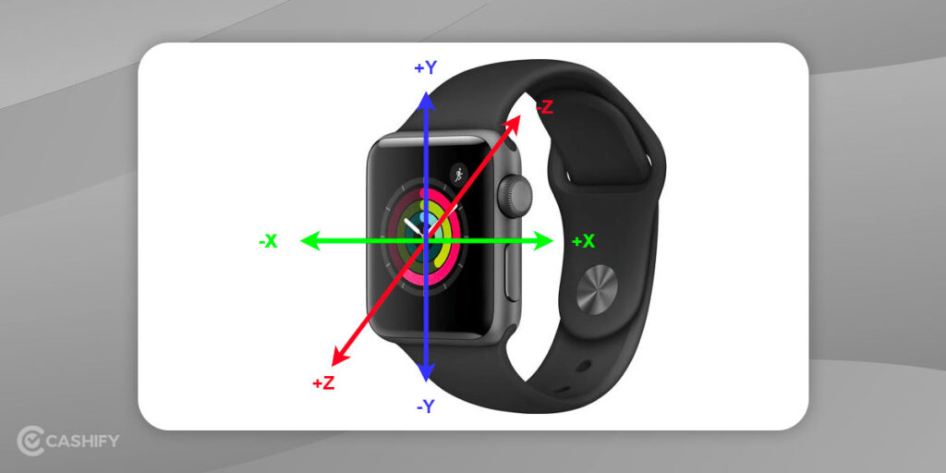
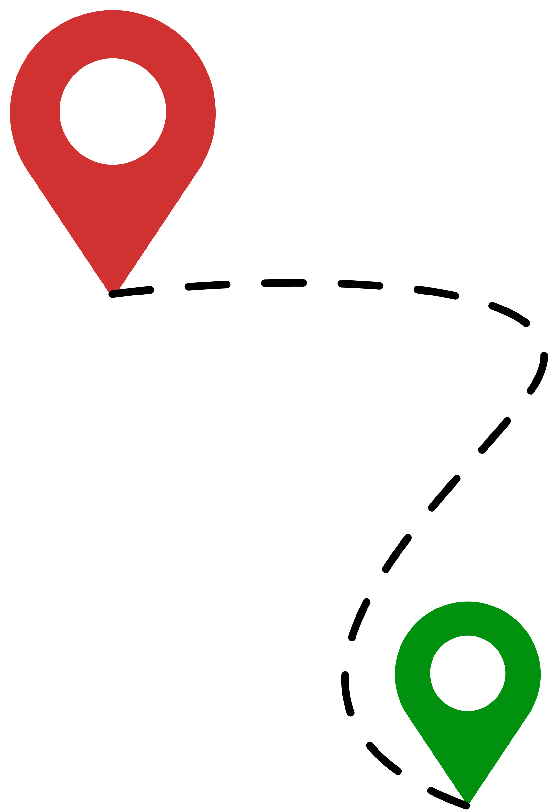
Sensors
Accelerometer:
Gyroscope
GPS (Global Positioning System):
Optical Heart Rate Sensor:
Barometer:
Temperature Sensor

Slide 18
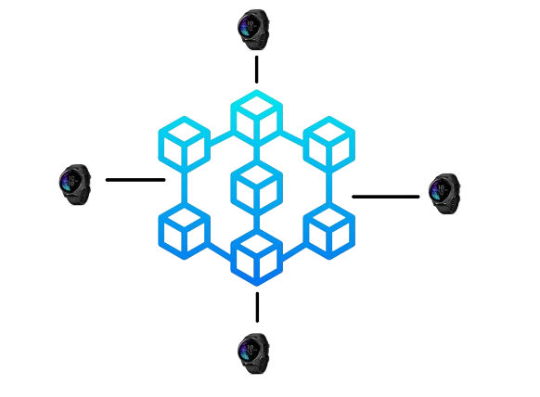
Communication system flow(Blockchain&IoT)
6.
Decentralized Integration
Lightweight nodes
ETH Embedded
OPTIMISATION?

Slide 19
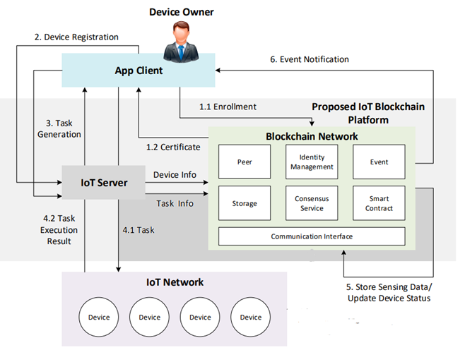
hYBRID APPROACH

Slide 20
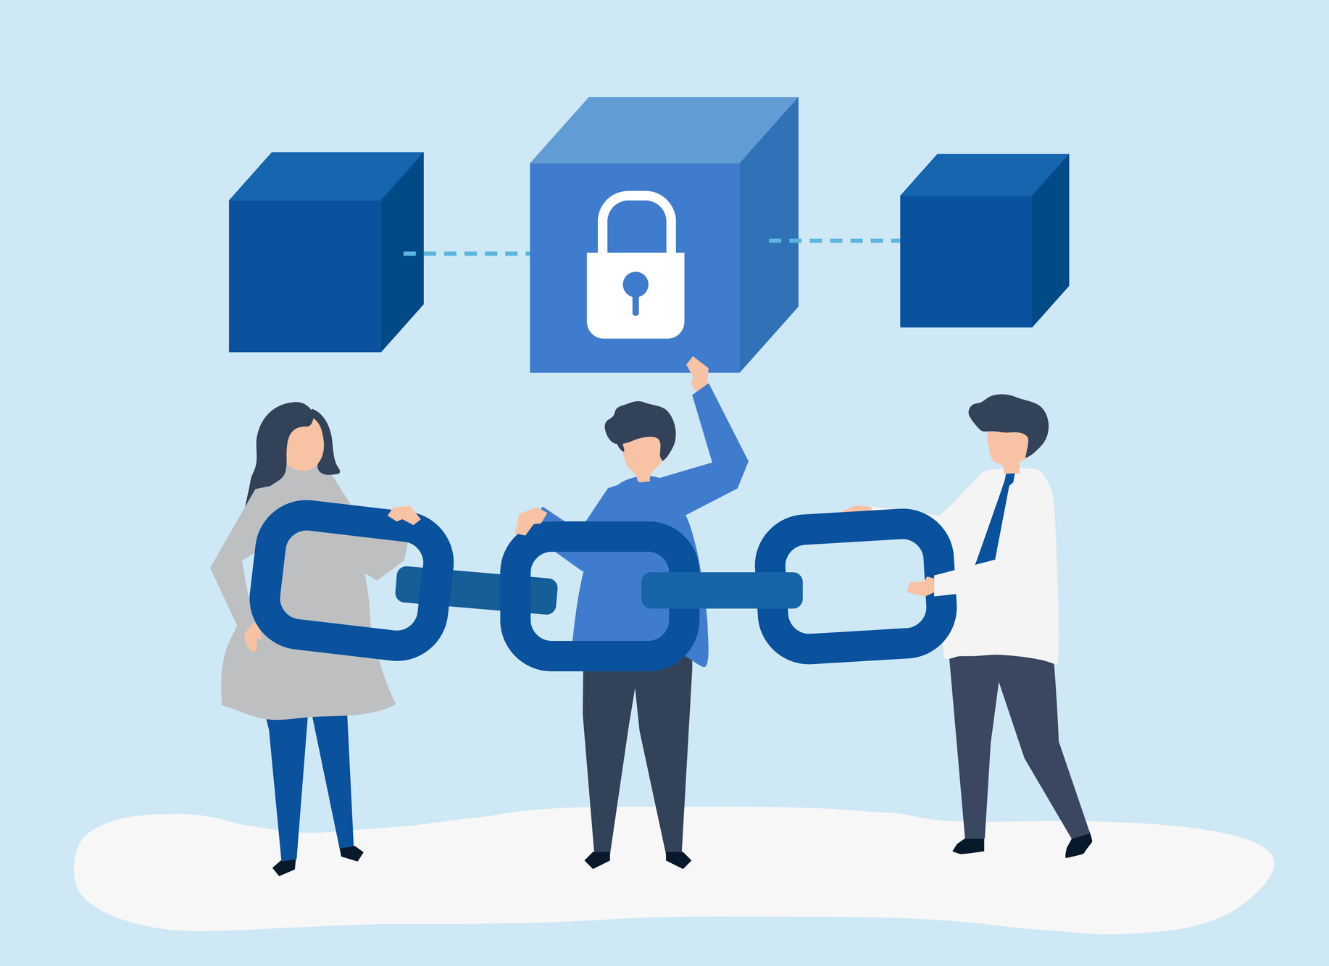
PROTOCOL
HTTPS
CoAP
MQTT

Slide 21
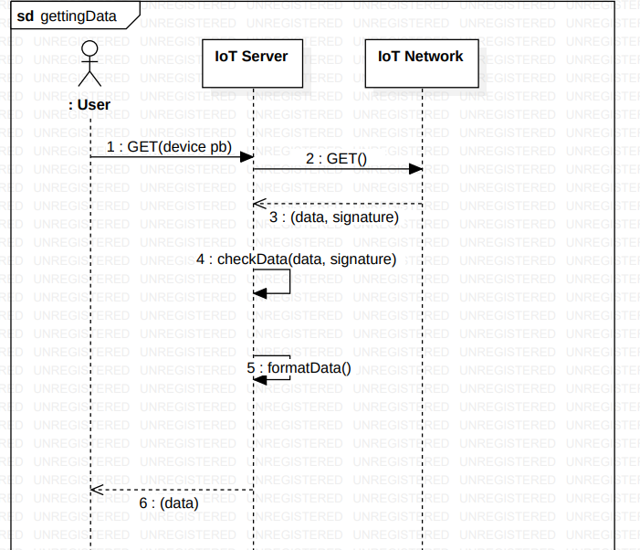
pROVIDING SECURITY

Slide 22

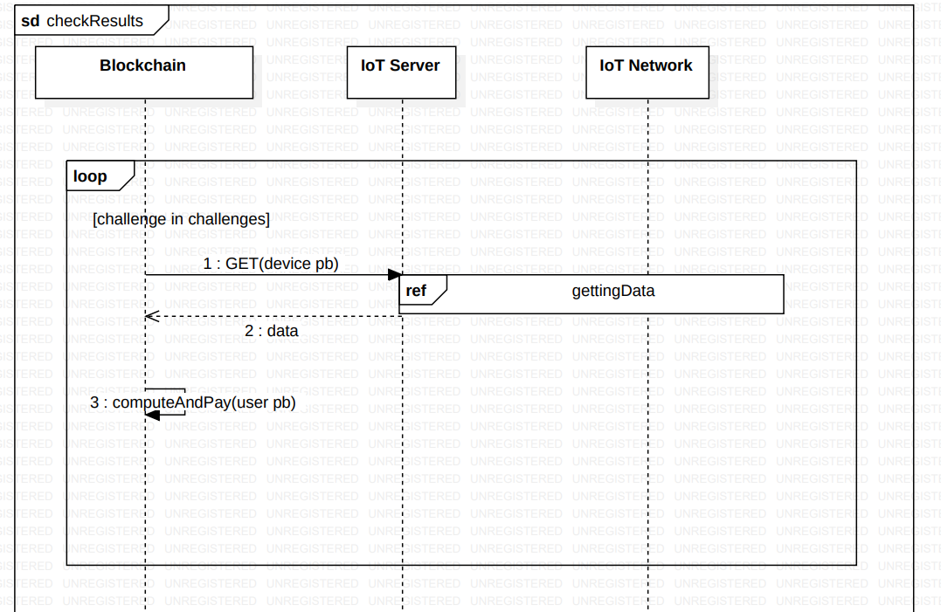
CHECKING CHALLENGES

Slide 23
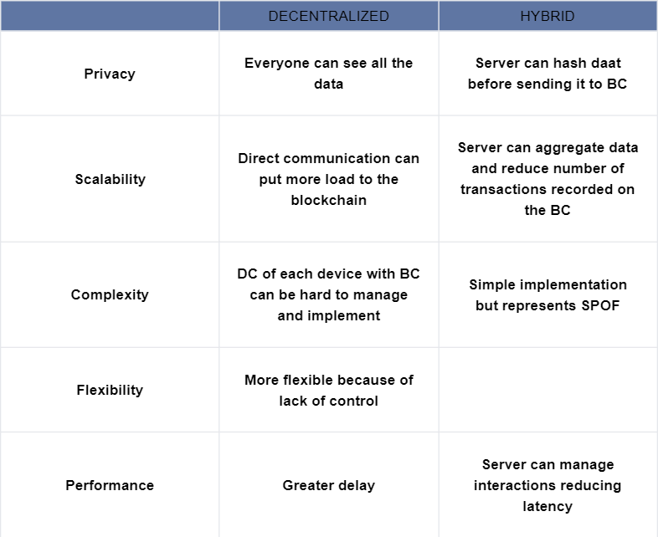
so which one is
better?

Slide 24
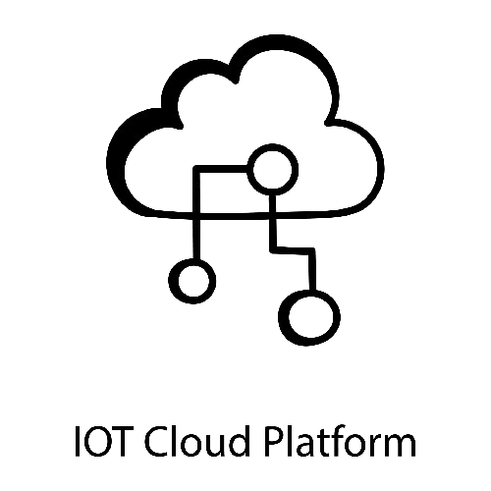
iNTEGRATION WITH CLOUD ARCHITECTURE?

Slide 25

demo

Slide 26


bENEFITS :
why to choose derunnER?
1
HEALTHY LIFESTYLE MOTIVATION
2
HAVE FUN & EARN
de
runner
3
COMMUNITY ECOSYSTEM
5
SMART WATCH FOR EVERY DAY STYLE
4
TRANSPARENCY& ENHACED SECURITY

Slide 27

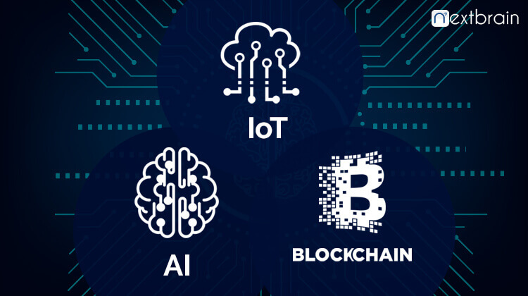
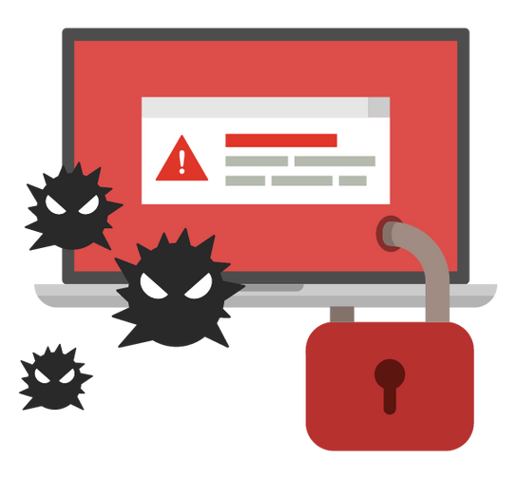
OBSTACLES : WHAT TO IMPROVE
1. Reliability on sensors (hardware)
2. Network overflow
3. Malicious users
optimisation?
ai integration?

Slide 28

Thank you !
de
runner

